Slide 1
FAKE NEWS DETECTION
Final RLMCA 351 Mini Project Review
Group No : 5
Members :
1. AMINA P M
2. JITHIN JOSEPH
3. SAGIL P
4. SHIRIN SHAHANA S
Guide Name: Ms.Rani Saritha R

Slide 2
Contents
1
Introduction
Objective
3
Literature Review
Proposed System
2
5
6
7
Technology
Dataset
Experiments and Results
Conclusion
4
8
9
References

Slide 3
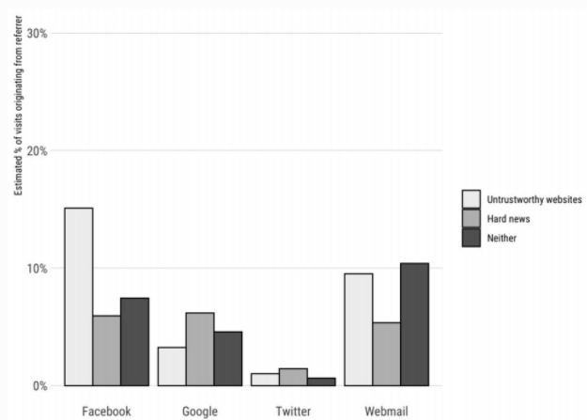
Introduction
What is Fake News ?
News designed to deliberately spread hoaxes, propaganda, and disinformation.
Social media sites – Facebook, Twitter, Reddit etc.
Mimics real headlines and twist the story.

Slide 4
Introduction
To produce a model - accurately predict the likelihood that a given article is fake news.
Using Machine learning algorithms , we have implemented certain methods and classifiers such as:
Decision Tree Algorithm
Naive Bayes Algorithm

Slide 5
Objective
To detect the fake news , which is a classic text classification problem with a straight forward proposition.
To develop an intelligent algorithm to detect the fake news in online platform by Decision Tree Algorithm and Naive Bayes Algorithm
To build a model that can differentiate between “Real” news and “Fake” news.

Slide 6
Literature Review
Papers Referred:
Fake News Detection Using Machine Learning Ensemble Methods [1]
They have used the following learning algorithms :
Logistic Regression
Support Vector Machine (SVM)
Multilayer Perceptron (MLP)
Fake Data Analysis and Detection Using Ensembled Hybrid Algorithm [2]
They have used the following learning algorithms :
Naive Bayes
Random Forest
Decision Tree
Support Vector Machine
K Nearest Neighbours

Slide 7
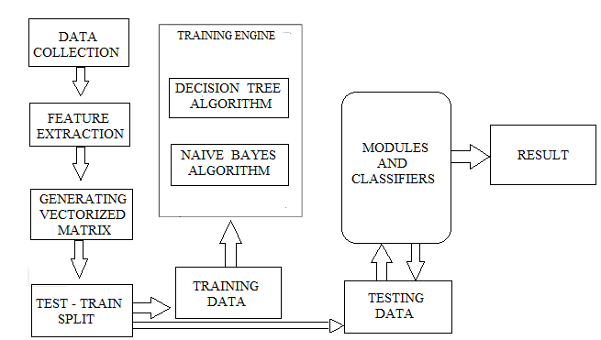
Proposed System
Workflow for training algorithms and classification of new articles

Slide 8
Technology
Language used – Python
Platform – Jupyter Notebook
Libraries used – os, numpy, pandas, sklearn
Algorithms used
Decision Tree Algorithm
Naive Bayes Algorithm

Slide 9
Dataset
Kaggle’s dataset.
Mix of both real and fake news.
Entire dataset - 4050 news articles
Collected data was processed using various text preprocessing measures and stored in CSV files.
Merged and shuffled - CSV file containing a consolidated randomized dataset.
From this dataset we picked 3500 records at random
Train data : 80%
Test data : 20%

Slide 10

Experiments and Results
Decision Tree algorithm
from sklearn.metrics import confusion_matrix
a = confusion_matrix(y_test, y_pred)
print(a)
Accuracy
95.0

Slide 11

Experiments and Results
Naive Bayes Algorithm
b = confusion_matrix(y_test, nvb_pred)
print(b)
Accuracy
91.56

Slide 12
Conclusion
Primary aim - to identify patterns in text that differentiate fake articles from true news.
Learning models were trained and parameter-tuned to obtain optimal accuracy.
Due to the implementation of two algorithms we’ve finalized with the better accuracy that is concerns to Decision Tree Algorithm.

Slide 13
References
I. Ahmad, Muhammad Yousaf, Suhail Yousaf and and M.O. Ahmad, “Fake News Detection Using Machine Learning Ensemble Methods”, Complexity in Deep Neural Networks, Hindawi
2) P. B. P. Reddy, M. P. K. Reddy, G. V. M. Reddy and K. M. Mehata, "Fake Data Analysis
and Detection Using Ensembled Hybrid Algorithm," 2019 3rd International Conference on Computing Methodologies and Communication (ICCMC), Erode, India, 2019, pp. 890-897

Slide 14
Thank You

